Slide 1

Introduction to Ocean Thermal Energy Conversion (OTEC)
PRESENTED BY:
AHLAM SHEIKH

Slide 2
Introduction to Ocean Thermal Energy Conversion (OTEC)
Ocean Thermal Energy Conversion (OTEC) is a renewable energy technology that utilizes the temperature difference between the warm surface water and the cold deep ocean water to generate electricity.

Slide 3
Conventional OTEC System: Overview and Components
Warm Water Inlet
Evaporator
Condenser
Warm surface water is pumped into the system, typically at a temperature of 25°C or higher.
The warm water is passed through an evaporator, where it boils a working fluid, usually ammonia.
The cold water from the depths is pumped into a condenser, where it cools and condenses the working fluid.

Slide 4





Working Principle of a Conventional OTEC System
Warm Water Inlet
Warm surface water is pumped into the system, typically at a temperature of 25°C or higher.
Evaporator
The warm water is passed through an evaporator, where it boils a working fluid, usually ammonia.
Turbine
The expanding ammonia vapor drives a turbine, generating electricity.
Condenser
The cold water from the depths is pumped into a condenser, where it cools and condenses the working fluid.
Pump
The condensed ammonia is pumped back to the evaporator, completing the cycle.

Slide 5
Advantages and Disadvantages of Conventional OTEC
1
Renewable Energy Source
2
Low Greenhouse Gas Emissions
OTEC utilizes the natural temperature difference of the ocean, providing a continuous and sustainable energy source.
OTEC is a clean energy technology with minimal greenhouse gas emissions compared to fossil fuels.
3
Potential for Co-Production
4
High Capital Costs
OTEC can be used to produce fresh water, aquaculture products, and other valuable byproducts.
The construction and operation of OTEC plants can be expensive, requiring significant upfront investment.

Slide 6
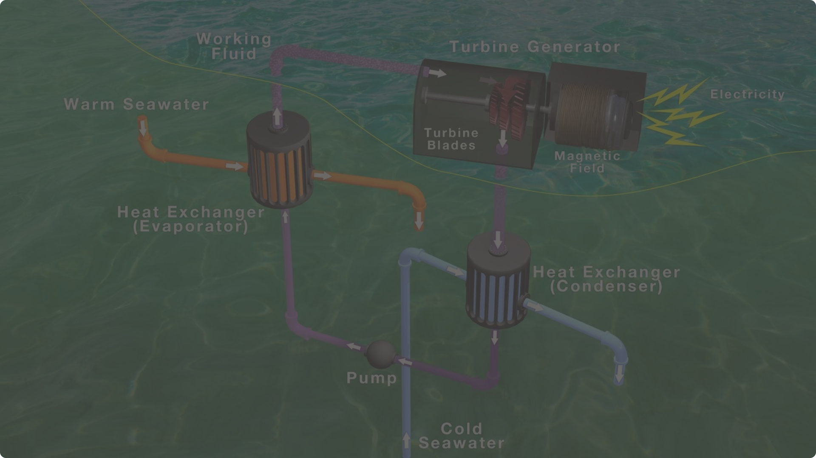
Future Prospects and Challenges of Conventional OTEC
Technological Advancements
Environmental Considerations
Ongoing research and development are focused on improving the efficiency and reducing the cost of OTEC systems.
Careful planning and environmental impact assessments are essential to ensure the sustainable operation of OTEC plants.
1
2
3
Policy Support
Government policies and incentives are crucial for promoting the development and deployment of OTEC technology.

Slide 7
THANK YOU

